Slide 1
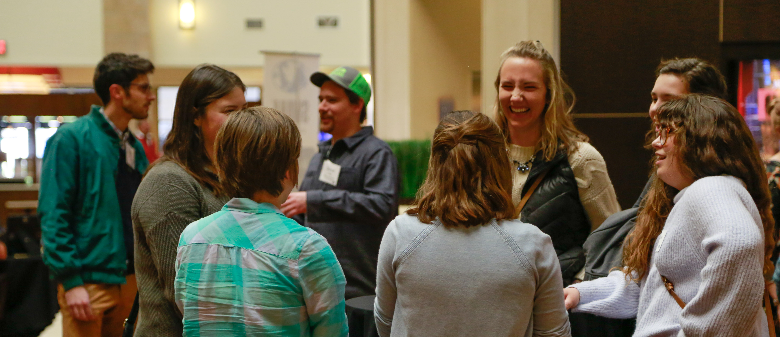
SWANA MN / ND Annual Meeting 2021
1

Slide 2
Agenda
2021 in Review
Webinars and Conferences
Advisory Board Update
Applied Research Foundation
Treasurer’s Report
2022 Upcoming Events
Goals for 2022
Board Election Results
2

Slide 3
2021 in Review
Membership: 165 members from MN, ND, and SD
2021 Goals
Host short, bi-monthly educational webinars
Host an outdoor fundraiser event that will recur annually
Identify new creative educational opportunities for members
Develop and institute an annual philanthropic event for networking and outreach
Revisit the Floyd Forsberg Scholarship
Maintain a checking account balance greater than $5,000
Webinars
Demolition Webinar Series: 2/9, 2/16, 2/23, 3/2, 3/9
Solid Waste Operator Webinar Series: 5/13, 5/20, 5/27
RAM/SWANA Webinar Series: 9/16, 9/22, 9/30, 10/7, 10/14, 10/26, 10/28, 11/4
In-Person Events
Back-to-Networking Event at HDR: 10/19
MN/ND Networking Event: 11/9
3

Slide 4
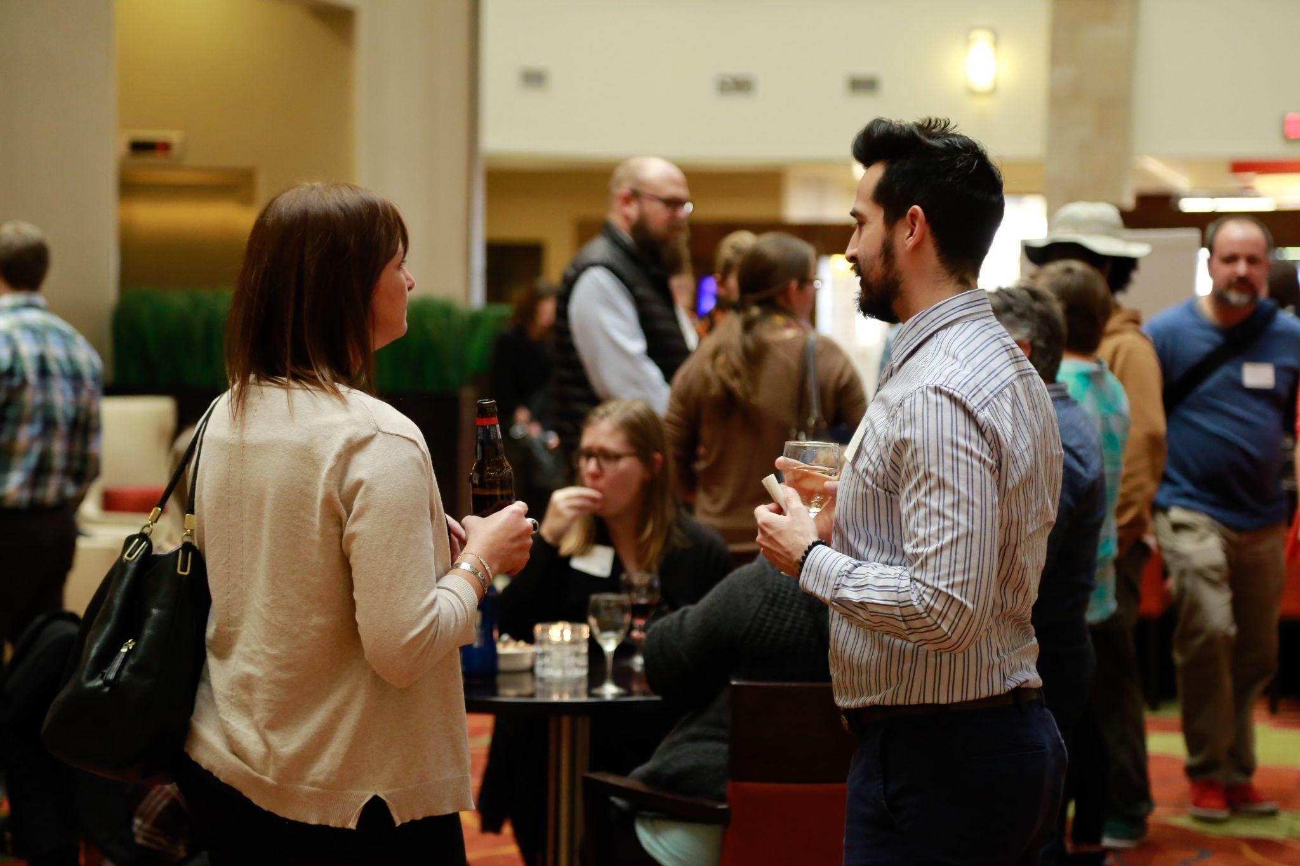
Webinars and Conferences
Mark your calendars!
2022 RAM/SWANA Conference
May 2-3, 2022
Interested in presenting? Email proposals to director@gmail.com
2022 Solid Waste Operator Training
February 22, 2022
Holiday Inn St. Cloud
4

Slide 5
Advisory Board Update – National
Board of Directors and Advisory Board Annual Meeting held live in advance of WASTECON in October (Kissimmee, FL)
SWANA voted to approve the Final ISWA Climate Declaration 2021
Chapter Survey - strong on safety and advocacy, but lacking in chapter engagement and recruiting of new members (strategy focus)
Currently 10,782 total members, although YP numbers declining somewhat (strategy focus)
New MOLO Program – 13 modules, customized learning, hard-copy and electronic, detailed exam
Clean audit, increased assets in 2021, Gershman Scholarship, stock market, PPP loan forgive
6

Slide 6
Advisory Board Update – Strategic Planning
Four Summer Working Groups: Events/Connections, Safety, SME, YP
Sense and Sensemaking over summer months w/ TED talks Presented at Strategy Session in Florida pre-WasteCon
Five Drivers of Change within Solid Waste (Common to Working Groups)
Shifting Worker Priorities (confidence, dissatisfaction, burnout, reassess, quality of life)
Increasing Impacts from Climate Change (attitudes, economics, etc)
Expanding Use for Technology, AI, and Automation (In cab, automation/robotics, tracking)
Expanding Value for Resources and Circular Economy (ESG, EPR, Zero Waste, Circular Economy)
Changing Norms for Meetings and Connection (Budgets, Climate Change, Time)
Four “Big Hairy Audacious Goals” Responding to Drivers of Change
Work Out of the Top Ten (EPR, Safety, Training, Collaboration)
Become Climate Champions (emphasize resource management, organics management)
Reframe Perception of Industry as Employer of Choice (DEI Initiative, YP Leadership)
Continue to Strengthen Infrastructure and Financial Sustainability (membership, chapters, training and communication, hybrid events)
5

Slide 7
Advisory Research Foundation
Our Chapter is now part of the SWANA Applied Research Foundation. Through the ARF, SWANA Chapters can access papers from 4 possible group categories by paying a membership fee. Research is industry-funded.
This fall, our chapter voted to access papers from the topics of Waste Conversion and Energy Recovery, as well as Sustainable Materials Management.
6

Slide 8
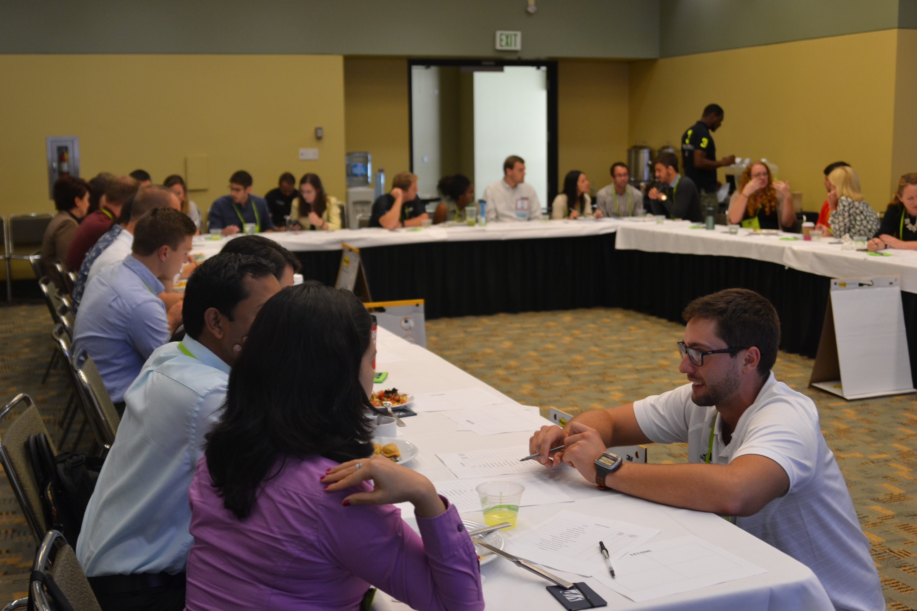
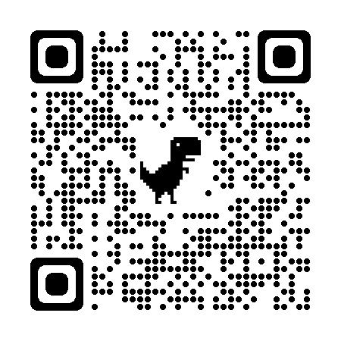
YP Membership – Development/Engagement
YP or ‘Young Professional’
Emerging professionals in the industry, age 35 or younger
YP membership discount: $100 year 1, $150 year 2, $200 year 3
MentorMatch Program, online discussion communities, National liaison calls
MN-ND Chapter networking events
Student engagement
SWANA student membership = FREE!
Hickman Future Leaders: establishing connections with MN-ND universities, trade schools, certification and training programs
Floyd Forsberg Scholarship
7

Slide 9
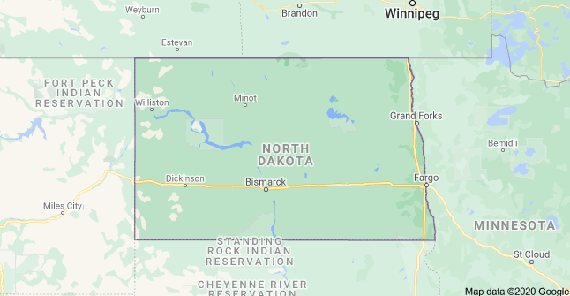
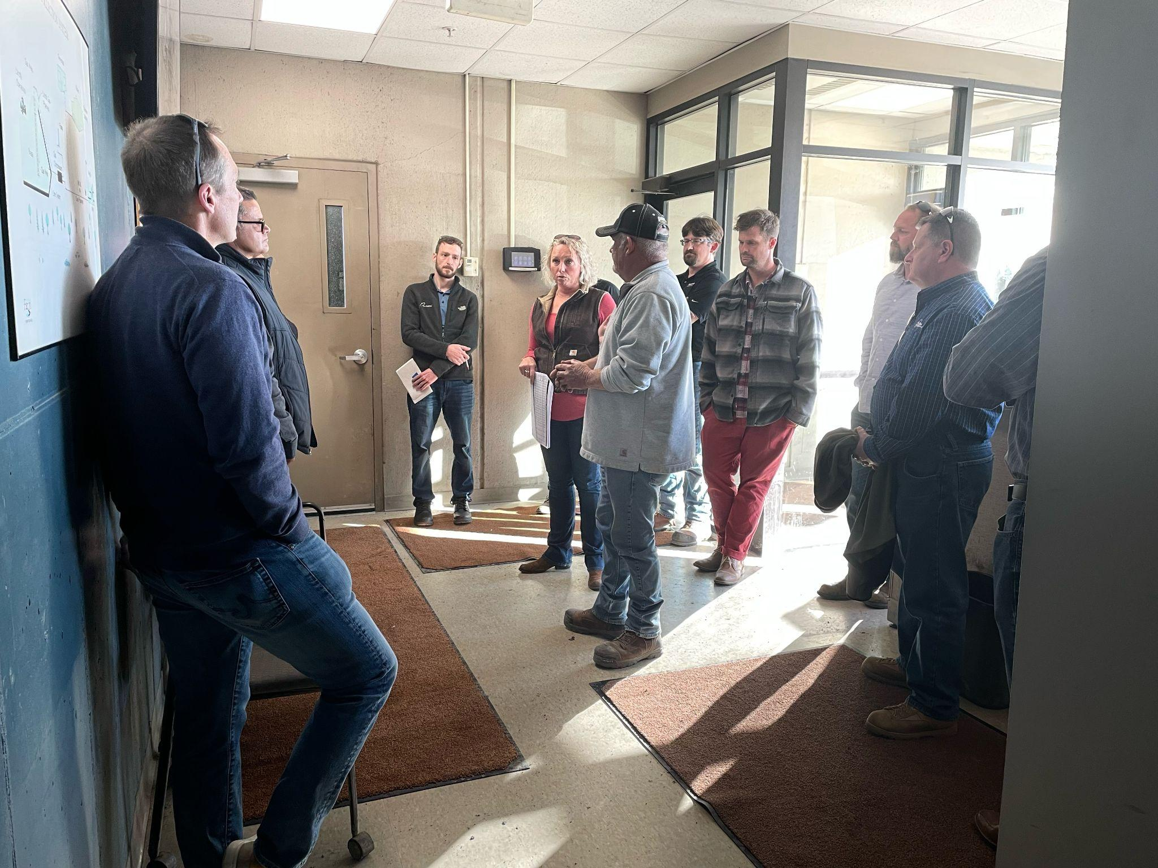
North Dakota Incorporation
Incorporation of North Dakota Members into Minnesota Chapter
Event in Fargo
Tour of Pactiv Corp. egg carton production plant
Tour of City of Fargo Landfill Gas Reuse facilities
Networking Happy Hour at Drekker Brewing
Two North Dakota Board Members starting in 2022
Continuing to look for ways to be more inclusive of North Dakota Members
8

Slide 10
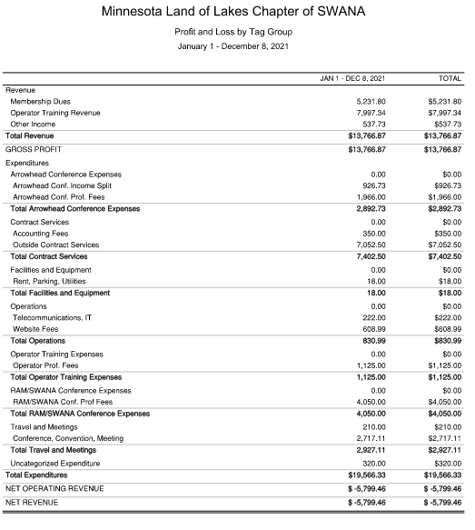
Treasurer’s Report
2021 Expenditures:
Total Revenue - $13,766.87
Total Expenses - $19,566.33
Net Revenue – ($5,799.46)
Expected due to COVID – 19 – Pending RAM Webinar income
SWANA National – Paid General Liability Insurance - $700.00
Maintained $5,000 checking account balance
Maintained $40,000 CD’s as back-up
2022 Goals:
Develop written procedures & processes for Treasurer role
Document Operator Training process for reconciliation with AWMA
Document RAM/SWANA Annual Conference process for reconciliation
9

Slide 11
Upcoming Events
2022! New Year, New Opportunities
Goal: Deliver more options that foster enhanced networking, philanthropic opportunities, and allow for creative learning opportunities for our members.
New collaborative event options being explored include but not limited to:
Fundraiser such as a golf outing
Collaborative activity with outside nonprofit or private partners
Continuance of webinars on a bi-monthly cadence
RAM/SWANA Spring Conference
Solid Waste Operators Conference (SWANA and AWMA)
To advance the practice of environmentally and economically sound management of municipal solid waste in North America.
11
Notes:
Joint event with another group that is less directly a part of our industry (e.g. second harvest, CUB/UNFI), River Clean up
Fall conf based on current state conditions related to Covid and other state relevant events that could hinder.
This Photo by Unknown Author is licensed under CC BY-NC-ND

Slide 12
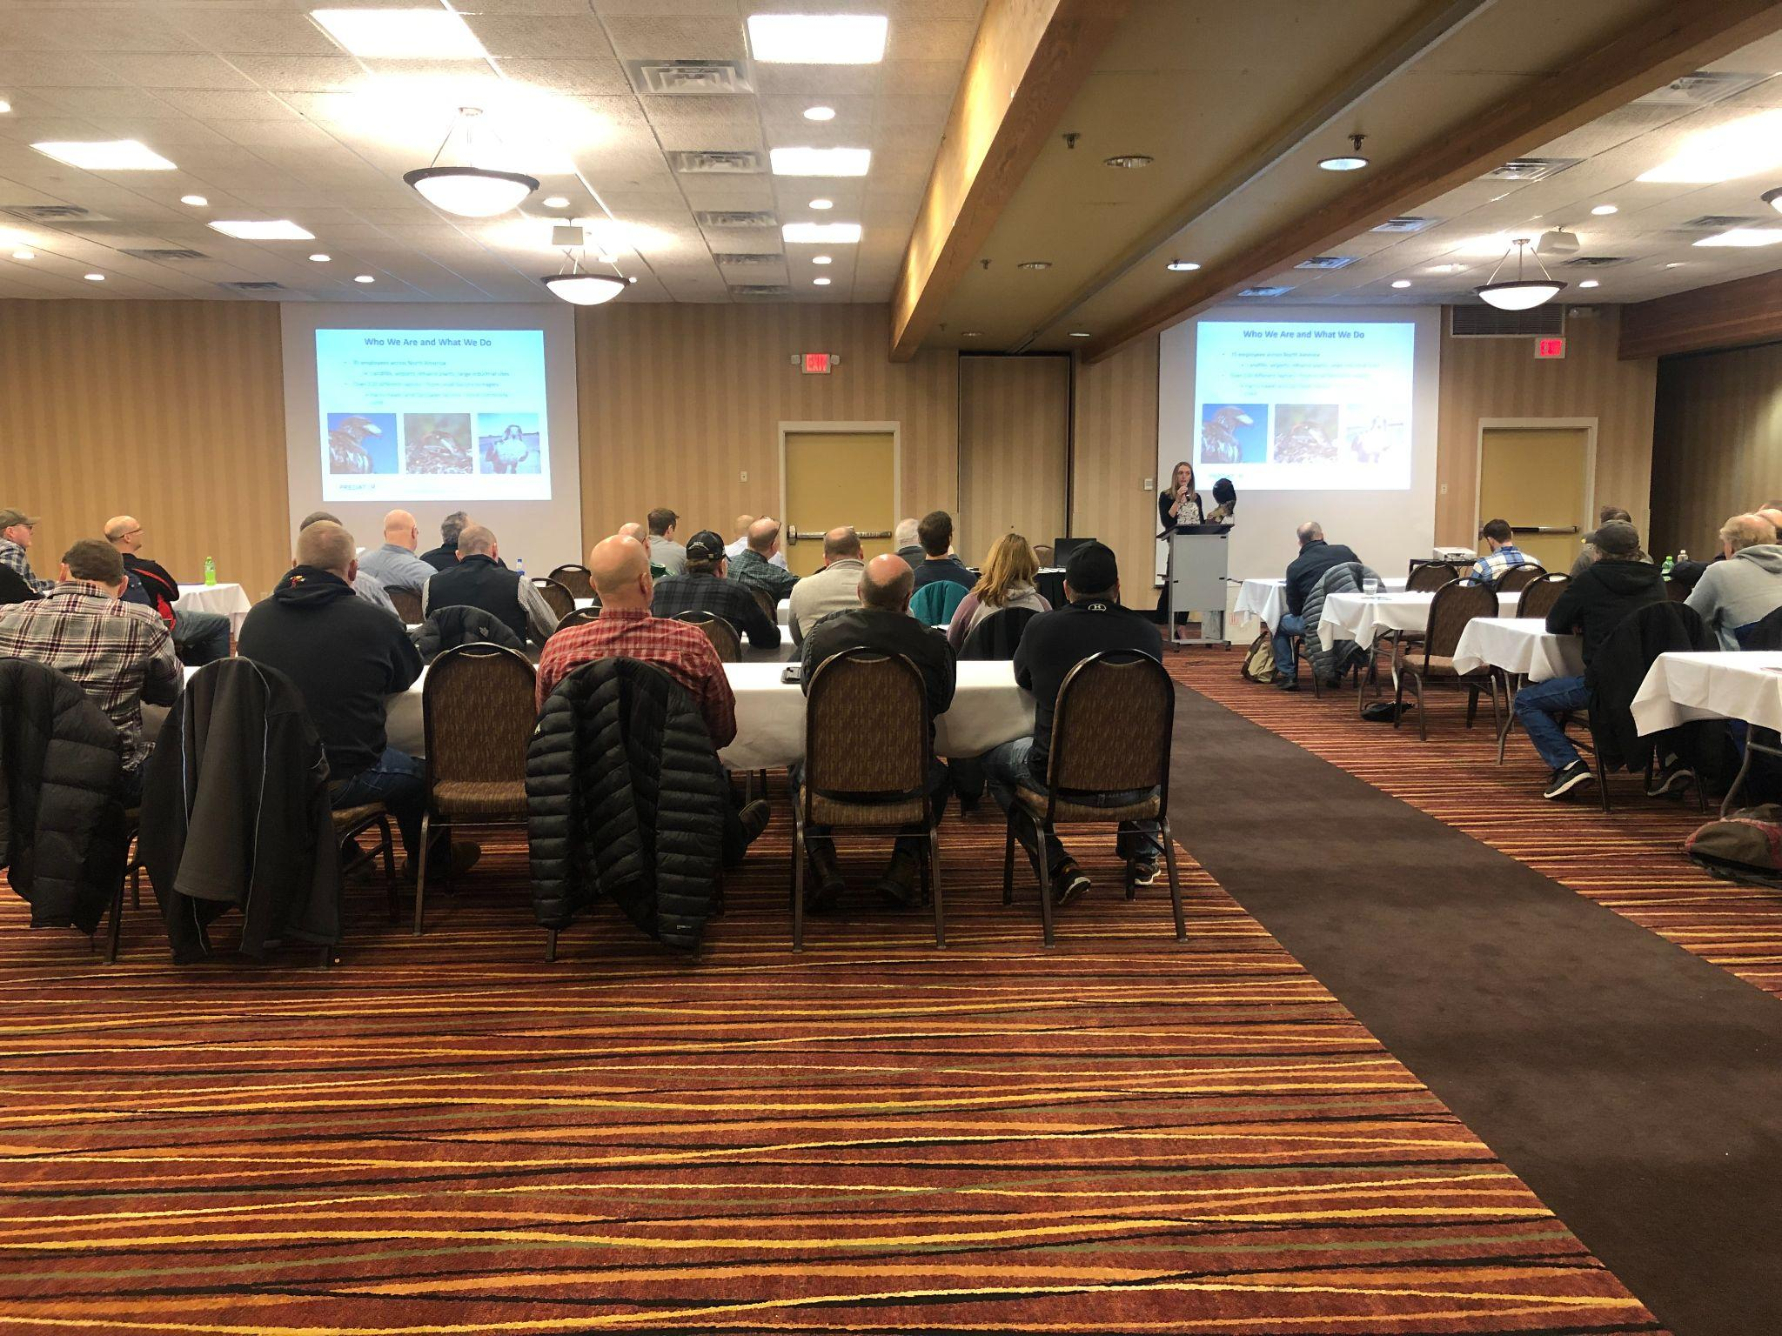
Goals for 2022
Host successful conferences in February and May
Continue hosting educational webinars
Identify new creative educational opportunities for members
Maintain and strengthen ties with other similar organizations
Maintain a checking account balance greater than $5,000
12

Slide 13
Board Election Results
Re-elected
Newly Elected
Don Chapdelaine
Matt Evans
Robert Friend
Jennefer Klennert
Bruce Rehwaldt
Rebecca Richert
Peder Sandhei
Nathan Klett
Shawn ONeill
Jen Pickett
Welcome, new board members!

Slide 14
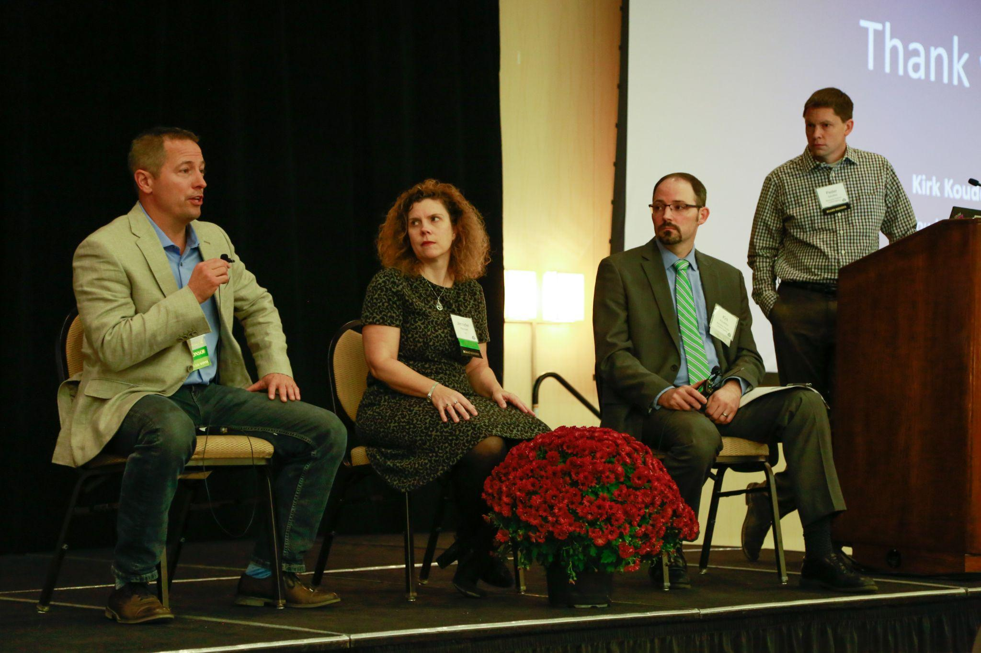
Thank you!
Questions or comments welcome!
Follow along with us:
swanamn.org
Linkedin - SWANA Minnesota Group
Director@swanamn.org

